Slide 1



Mean Field Approximation
Defining mean field (molecular field or effective field) & mean field Hamiltonian
$$S_{i}=\left\langle S_{i}\right\rangle +\left(S_{i}−\left\langle S_{i}\right\rangle \right)$$
$$S_{i}S_{j}=\left(\left\langle S_{i}\right\rangle +\left(S_{i}−\left\langle S_{i}\right\rangle \right)\right)\left(\left\langle S_{j}\right\rangle +\left(S_{j}−\left\langle S_{j}\right\rangle \right)\right)$$
$$S_{j}=\left\langle S_{j}\right\rangle +\left(S_{j}−\left\langle S_{j}\right\rangle \right)$$
0
$$S_{i}S_{j}=\left\langle S_{i}\right\rangle \left\langle S_{j}\right\rangle +\left\langle S_{i}\right\rangle \left(S_{j}−\left\langle S_{j}\right\rangle \right)+\left\langle S_{j}\right\rangle \left(S_{i}−\left\langle S_{i}\right\rangle \right)+\left(S_{i}−\left\langle S_{i}\right\rangle \right)\left(S_{j}−\left\langle S_{j}\right\rangle \right)$$
term quadratic in fluctuations
$$S_{i}S_{j}≈\left\langle S_{i}\right\rangle \left\langle S_{j}\right\rangle +\left\langle S_{i}\right\rangle \left(S_{j}−\left\langle S_{j}\right\rangle \right)+\left\langle S_{j}\right\rangle \left(S_{i}−\left\langle S_{i}\right\rangle \right)$$

Slide 2
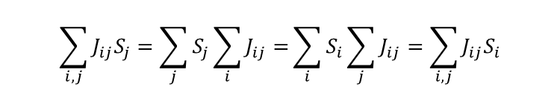
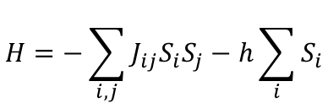
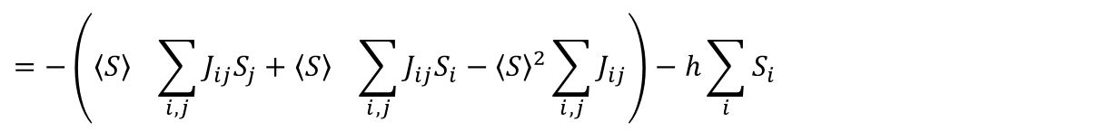
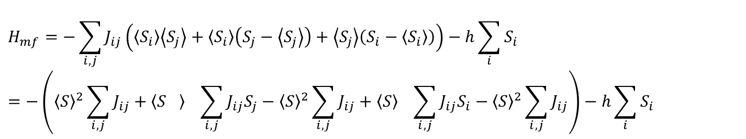

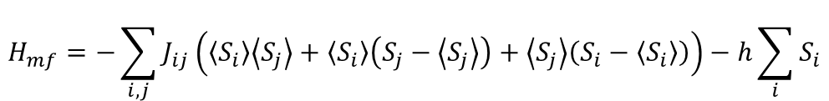
Mean field Hamiltonian
$$H=−\sum_{i,j}{J_{ij}S_{i}S_{j}}−h\sum_{i}{S_{i}}$$
$$H_{mf}=−\sum_{i,j}{J_{ij}\left(\left\langle S_{i}\right\rangle \left\langle S_{j}\right\rangle +\left\langle S_{i}\right\rangle \left(S_{j}−\left\langle S_{j}\right\rangle \right)+\left\langle S_{j}\right\rangle \left(S_{i}−\left\langle S_{i}\right\rangle \right)\right)}−h\sum_{i}{S_{i}}$$
Note I dropped here the factor ½ introduced previously
to keep the notation simple.
How is H_{mf} simplifying the problem?
$$\left\langle S_{j}\right\rangle =\left\langle S\right\rangle =S_{av}$$
independent of summation index
$$H_{mf}=−\sum_{i,j}{J_{ij}\left(\left\langle S_{i}\right\rangle \left\langle S_{j}\right\rangle +\left\langle S_{i}\right\rangle \left(S_{j}−\left\langle S_{j}\right\rangle \right)+\left\langle S_{j}\right\rangle \left(S_{i}−\left\langle S_{i}\right\rangle \right)\right)−h\sum_{i}{S_{i}}}=−\left({\left\langle S\right\rangle }^{2}\sum_{i,j}{J_{ij}}+{\left\langle S_{}\right\rangle }^{}\sum_{i,j}{J_{ij}S_{j}}−{\left\langle S\right\rangle }^{2}\sum_{i,j}{J_{ij}}+{\left\langle S\right\rangle }^{}\sum_{i,j}{J_{ij}S_{i}}−{\left\langle S\right\rangle }^{2}\sum_{i,j}{J_{ij}}\right)−h\sum_{i}{S_{i}}$$
$$=−\left({\left\langle S\right\rangle }^{}\sum_{i,j}{J_{ij}S_{j}}+{\left\langle S\right\rangle }^{}\sum_{i,j}{J_{ij}S_{i}}−{\left\langle S\right\rangle }^{2}\sum_{i,j}{J_{ij}}\right)−h\sum_{i}{S_{i}}$$
$$\sum_{i,j}{J_{ij}S_{j}}=\sum_{j}{S_{j}\sum_{i}{J_{ij}}=}\sum_{i}{S_{i}\sum_{j}{J_{ij}}=\sum_{i,j}{J_{ij}S_{i}}}$$
using

Slide 3
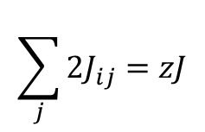
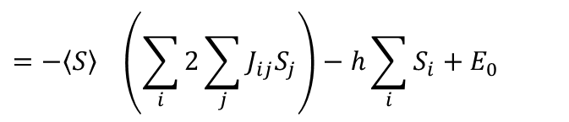
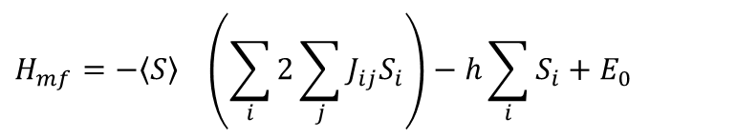
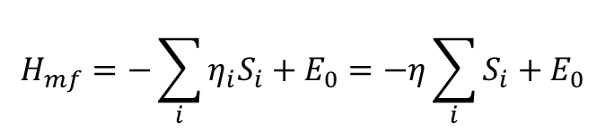
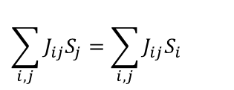

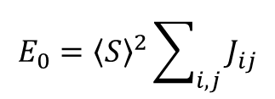

$$=−{\left\langle S\right\rangle }^{}\left(\sum_{i}{2\sum_{j}{J_{ij}S_{j}}}\right)−h\sum_{i}{S_{i}}+E_{0}$$
$$E_{0}={\left\langle S\right\rangle }^{2}\sum_{i,j}{J_{ij}}$$
where
independent of i,j
$$\sum_{i,j}{J_{ij}S_{j}}=\sum_{i,j}{J_{ij}S_{i}}$$
$$H_{mf}=−{\left\langle S\right\rangle }^{}\left(\sum_{i}{2\sum_{j}{J_{ij}S_{i}}}\right)−h\sum_{i}{S_{i}}+E_{0}$$
$$η_{i}=h+\left\langle S\right\rangle \sum_{j}{2J_{ij}}$$
with the mean field
For nearest neighbor interaction
identical for all nearest neighbors
such that, e.g., 2J₁₂=J
$$\sum_{j}{2J_{ij}}=zJ$$
with z= # of nearest neighbors
$$η=h+\left\langle S\right\rangle zJ$$
$$H_{mf}=−\sum_{i}{η_{i}S_{i}}+E_{0}=−η\sum_{i}{S_{i}}+E_{0}$$

Slide 4
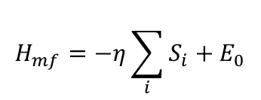

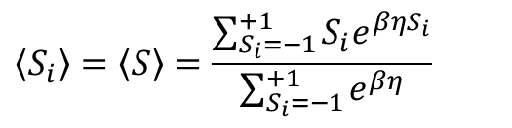

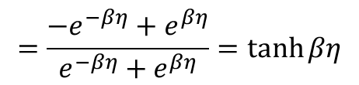

$$H_{mf}=−η\sum_{i}{S_{i}}+E_{0}$$
Thermodynamics of
is formally identical to non-interacting spins in a field
(paramagnetism)
For Ising spins with
$$S_{i}±1$$
$$\left\langle S_{i}\right\rangle =\left\langle S\right\rangle =\frac{\sum_{S_{i}=−1}^{+1}{S_{i}e^{βηS_{i}}}}{\sum_{S_{i}=−1}^{+1}{e^{βη}}}$$
$$=\frac{−e^{−βη}+e^{βη}}{e^{−βη}+e^{βη}}=\tanh{βη}$$
$$\left\langle S_{av}\right\rangle =\tanh{β\left(h+\left\langle S\right\rangle zJ \right)}$$
Zero field solution (h=0)
$$\left\langle S\right\rangle =\tanh{β\left(\left\langle S\right\rangle zJ \right)}$$

Slide 5
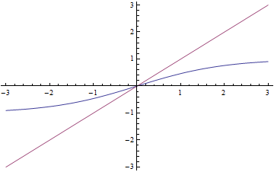
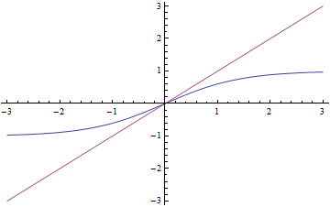
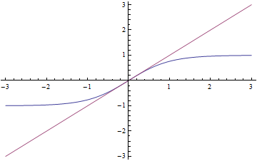
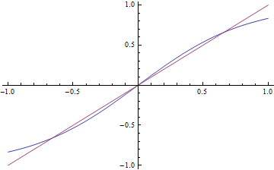

Let’s explore
$$y=\tanh{ay}$$
on variation of parameter a
a=0.5
a=0.7
a=1.0
a=1.2
Y=0.66
Y=-0.66

Slide 6
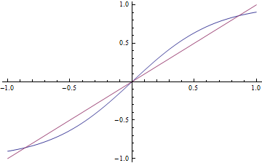
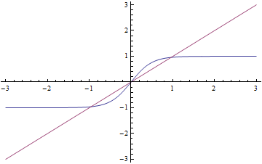


a=1.5
Y=0.86
a=2.0
Y=-0.86
For a<1 <S>=0 only solution
For a>1 two solution for non-zero <S>
It can be shown that the non-trivial solutions minimize the
free energy
a=1 defines the critical temperature T_{C}
$a=zJβ$=1
$$T_{C}=\frac{zJ}{k_{B}}$$
in mean field approximation

Slide 7
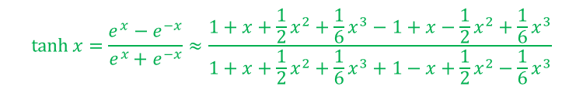


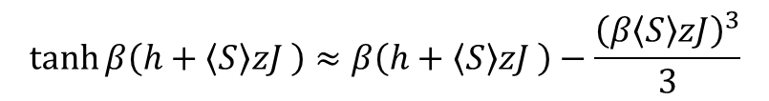



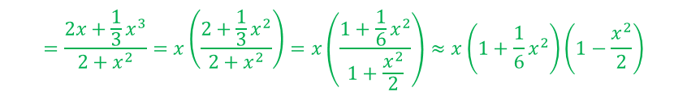
Discussion of the thermodynamics
T near the critical temperature T_{C}
$\left\langle S\right\rangle$->0
If we allow for a small applied magnetic field h such that $h≪\left\langle S_{av}\right\rangle zJ$
we can explore magnetization and susceptibility near T_{C}
$$\tanh{x}=\frac{e^{x}−e^{−x}}{e^{x}+e^{−x}}≈\frac{1+x+\frac{1}{2}x^{2}+\frac{1}{6}x^{3}−1+x−\frac{1}{2}x^{2}+\frac{1}{6}x^{3}}{1+x+\frac{1}{2}x^{2}+\frac{1}{6}x^{3}+1−x+\frac{1}{2}x^{2}−\frac{1}{6}x^{3}}$$
$$\left\langle S\right\rangle =\tanh{β\left(h+\left\langle S\right\rangle zJ \right)}$$
x≈0
$$=\frac{2x+\frac{1}{3}x^{3}}{2+x^{2}}=x\left(\frac{2+\frac{1}{3}x^{2}}{2+x^{2}}\right)=x\left(\frac{1+\frac{1}{6}x^{2}}{1+\frac{x^{2}}{2}}\right)≈x\left(1+\frac{1}{6}x^{2}\right)\left(1−\frac{x^{2}}{2}\right)$$
$\tanh{x≈x−\frac{x^{3}}{3}}$ +…
$$=x\left(1+\frac{1}{6}x^{2}−\frac{x^{2}}{2}−\frac{1}{12}x^{4}\right)≈x\left(1+\frac{1}{6}x^{2}−\frac{x^{2}}{2}\right)=x\left(1−\frac{1}{3}x^{2}\right)$$
$$\tanh{β\left(h+\left\langle S\right\rangle zJ \right)≈β\left(h+\left\langle S\right\rangle zJ \right)−\frac{{\left(β\left\langle S\right\rangle zJ\right)}^{3}}{3}}$$
$\left\langle S\right\rangle =βh+\frac{\left\langle S\right\rangle T_{C}}{T}−\frac{1}{3}{\left(\frac{\left\langle S\right\rangle T_{C}}{T}\right)}^{3}$
For T>T_{C} we can neglect the cubic term

Slide 8


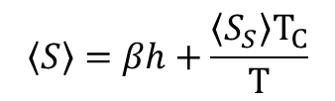
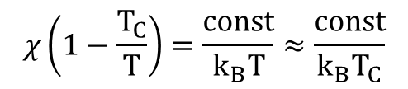

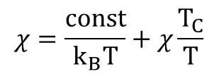
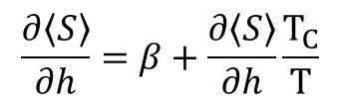



$$\left\langle S\right\rangle =βh+\frac{\left\langle S_{S}\right\rangle T_{C}}{T}$$
$$χ∝\frac{∂\left\langle S\right\rangle }{∂h}$$
with
$$\frac{∂\left\langle S\right\rangle }{∂h}=β+\frac{∂\left\langle S\right\rangle }{∂h}\frac{T_{C}}{T}$$
$$χ=\frac{const}{k_{B}T}+χ\frac{T_{C}}{T}$$
$$χ\left(1−\frac{T_{C}}{T}\right)=\frac{const}{k_{B}T}≈\frac{const}{k_{B}T_{C}}$$
$$χ∝\frac{T_{C}}{T−T_{C}}$$
T-dependence of <S> ($∝$magnetization) at h=0 near T_{C}
$$\left\langle S\right\rangle =0 for T>T_{C}$$
$T<T_{C}$:
$\left\langle S\right\rangle =\frac{\left\langle S\right\rangle T_{C}}{T}−\frac{1}{3}{\left(\frac{\left\langle S\right\rangle T_{C}}{T}\right)}^{3}$
1$=\frac{T_{C}}{T}−\frac{1}{3}{{\left\langle S\right\rangle }^{2}\left(\frac{T_{C}}{T}\right)}^{3}$

Slide 9


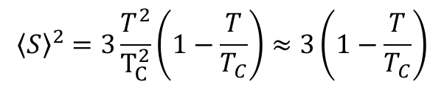


1$=\frac{T_{C}}{T}−\frac{1}{3}{{\left\langle S\right\rangle }^{2}\left(\frac{T_{C}}{T}\right)}^{3}$
3${\left(\frac{T}{T_{C}}\right)}^{3}=3\frac{T^{2}}{T_{C}^{2}}−{{\left\langle S\right\rangle }^{2}}^{}$
$${\left\langle S\right\rangle }^{2}=3\frac{T^{2}}{T_{C}^{2}}\left(1−\frac{T}{T_{C}}\right)≈3\left(1−\frac{T}{T_{C}}\right)$$
$$\left\langle S\right\rangle ∝\sqrt{T_{C}−T}$$
$$\left\langle S\right\rangle =\tanh{\frac{\left\langle S\right\rangle T_{C}}{T}}$$

